Slide 1
Video Assignment
Venkata Dusi
University of South Florida

Slide 2
Background
Currently pursuing Masters in Business Analytics from USF, Tampa.
Prior to my master’s I worked as a Commercial Analytics Engineer and was responsible for data collection and preparing dashboards using Tableau.
Interests and strengths :
Linear Regression extension to Logistic Regression
Decision Trees and use of Random Forests
Comfortable in Python as well as in R.

Slide 3
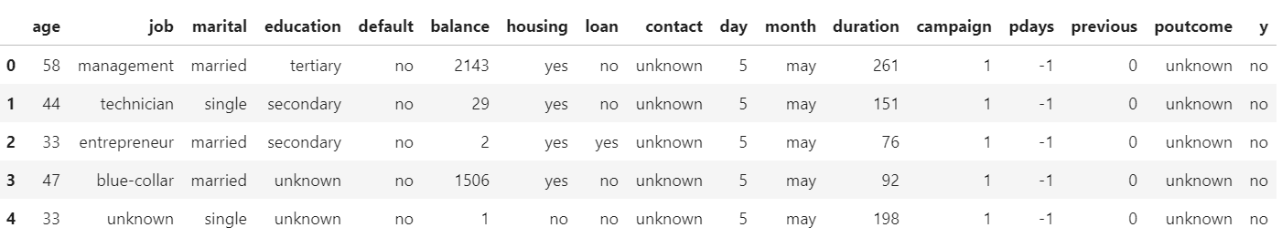
Building Recommendation System:
The problem:
The Bank Management team wants to do a targeted marketing campaign and wants to know given the profile of the clients whether they would be subscribe to term deposit or not.
Data:
Sample: 45211 customers.
DV: Subscribe or Not (1=Subscribed or 0=did not subscribe).
IV: Age, Job Type, Marital Status, Education level, credit default (Y/N), Balance, Housing loan (Y/N), Personal Loan(Y/N) and previous call details.

Slide 4
Approach:
Goal is to classify our DV (target variable) based on user profiles and to derive insights.
Logistic Regression being an extension of Linear Regression, we can have a good explanatory analysis between IV and DV as well as classify the DV.
Once classification is done, we can choose a given customer and predict if he/she would subscribe to a term deposit or not.

Slide 5
Challenges
The dataset had 17 attributes and first challenge was to identify which attributes to include?
There were 2 components of attributes: Customer profile and Previous marketing calls related.
Since the marketing manager would be interested in knowing if a customer would respond to a marketing call or not, ‘prior’ making the call, it is not right to include in predictive model.
Again, within customer profile data, we have to identify attributes that do not contribute much towards predicting the target variable.

Slide 6
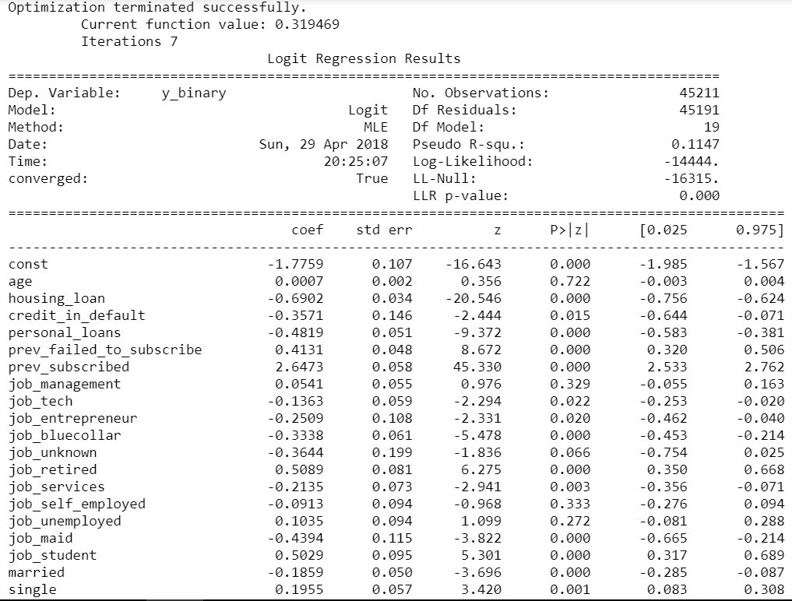
The Model: attempt 1
Using statsmodel.api in python we can have a measure of statistical significance of a given variable.
For Ex. Age attribute had a P value >0.05 which implies it is statistically not significant in predicting the outcome.
Similarly attributes such as job_self employed and job_unemployed had P values >0.05 so they too are not significant in predicting the outcome.

Slide 7
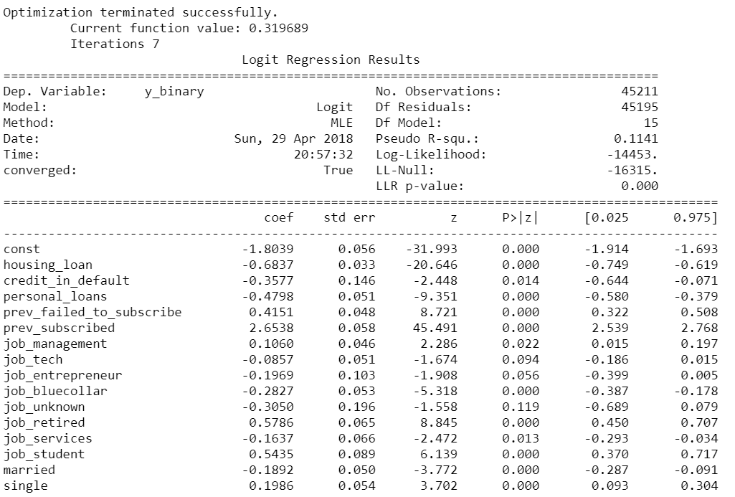
The Model: attempt 2
Again here we can observe that P value of job_tech >0.05 and thus can be avoided in the final model

Slide 8
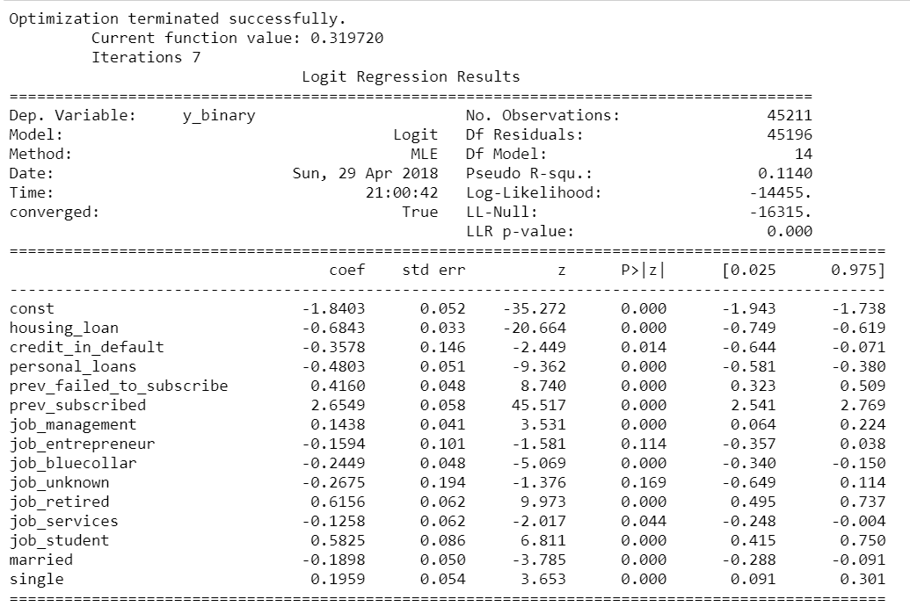
Final Model:
Is this a good model?
The answer lies in model evaluation. But logistic regression like linear regression has ‘explaining ability’ encoded.
For ex. The odds of a customer with credit default accepting additional term deposit is exp(-0.35) = 0.7 ie. 30% less than a customer having good credit history.

Slide 9
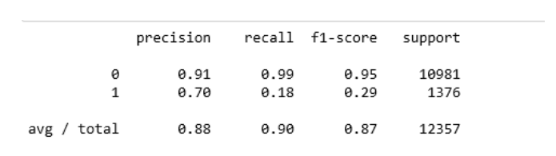
Model Evaluation:
The mean of 10 fold cross validation accuracy is 0.89
The Precision-Recall matrix:
Interpretation:
Precision Value : Of the entire test set, 88% of the promoted term deposit were the term deposit that the customers liked.
Recall Value : Of the entire test set, 90% of the customer’s preferred term deposits that were promoted.

Slide 10
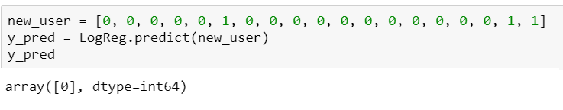
Insights to Managers:
What can our Manager the stake holder can learn from this analysis?
If a manager wants to know given a user profile whether or not he/she will respond positively for a term deposit marketing campaign. For Ex. Sam is a single divorcee who works in management and is not in credit default.
Based on the data, the customer can be coded into a test point and his behavior can be predicted as shown.

Slide 11
Insights to Managers (..contd)
The advantage of logistic regression model for this type of classification is that we can quantify relationships within the feature and see how they vary with DV.
The odds of a customer responding positively for a term deposit given that he was previously subscribed to a similar marketing campaign is exp(2.65) = 14 to 1.
The odds of a customer responding positively to this marketing campaign is 46% higher if he is in management against being in blue collar job.
Similarly the odds of a customer responding positively to this marketing campaign is 135% higher if he is retired as compared to being in blue collar job.

